Slide 1

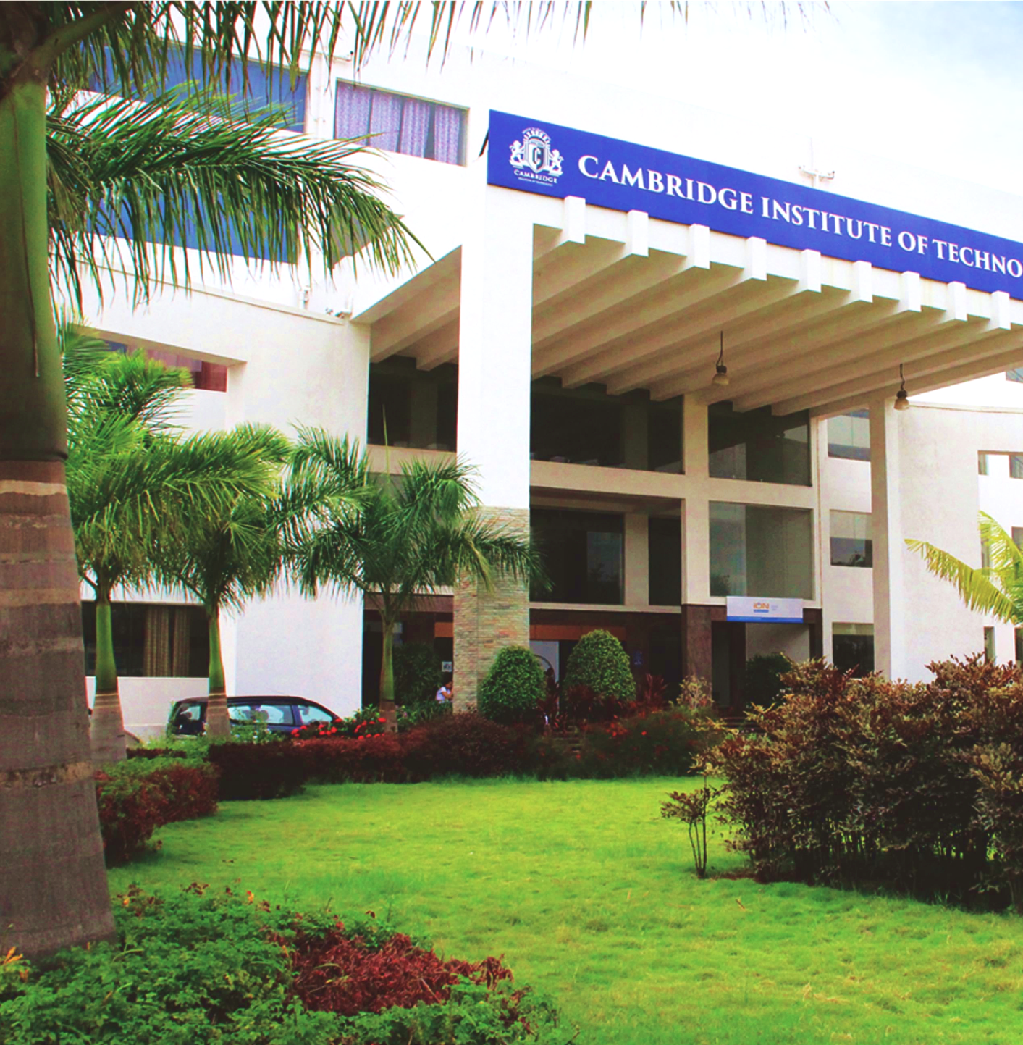
Department of Artificial Intelligence And Machine Learning Engineering
AI &ML APPLICATION AND DEVELOPMENT LABORATORY -18AIL76
MINI PROJECT ON
CONVERSE AI-BUILDING A SMART CHATBOT
USING NLP
PRESENTED BY :
LISHA M 1CD20AI026
P AADITYA 1CD20AI037
Under the Guidance of:
Project Guide : Dr.Buddesab
Project Guide : Prof. Syed Hayath

Slide 2
CONTENT
ABSTRACT
INTRODUCTION
SYSTEM REQUIREMENTS
SYSTEM DESIGN
IMPLEMENTATION
SYSTEM TESTING
CONCLUSION AND FUTURE ENHANCEMENT
Dept of AI&ML
www.cambridge.edu.in

Slide 3
ABSTRACT
Innovative AI Project: ConversAI is a groundbreaking project at the forefront of AI innovation, focusing on building a smart chatbot using NLP.
NLP Fundamentals: The project delves into the intricate realm of NLP fundamentals, leveraging advanced frameworks like TensorFlow and PyTorch.
Data Preparation Emphasis: Meticulous data preparation is a primary focus, ensuring the chatbot's robustness and effectiveness in understanding user input.
Sophisticated Architecture Design: ConversAI aims to push the boundaries of conversational AI through the design of a sophisticated architecture, combining theoretical foundations with practical implementation.
Showcasing NLP Technologies: The project aspires to create a chatbot that not only understands and responds to human language but also showcases the capabilities of stateoftheart NLP technologies.
Dept of AI&ML
www.cambridge.edu.in

Slide 4
INTRODUCTION
Project Focus: ConversAI aims to develop an intelligent chatbot using NLP for enhanced conversational interactions.
Digital Communication Emphasis: In a digitallydriven world, the project addresses the need for smart and responsive chatbots.
NLP Integration: ConversAI utilizes NLP to understand and generate humanlike responses, providing a seamless conversational experience.
Advanced Techniques: The project combines advanced language models and cuttingedge AI techniques to achieve its goals.
Dept of AI&ML
www.cambridge.edu.in

Slide 5
User Engagement: By leveraging NLP, ConversAI enhances user experiences with natural, efficient, and personalized interactions.
Diverse Domains: ConversAI finds applications in
customer support
healthcare assistance
educational support
social interaction and more.
Dynamic Chatbots: ConversAI explores the capabilities of NLP in creating dynamic chatbots that adapt to various scenarios.
Tailored Experiences: Through its versatile applications, ConversAI addresses the diverse needs of users, providing tailored and effective interactions.
Dept of AI&ML
www.cambridge.edu.in

Slide 6
Hardware Requirements
Processor: A modern multi-core processor (e.g., Intel Core i5 or equivalent)
Memory: 8 GB RAM
Graphics Card (GPU): Optional but highly recommended.
A dedicated GPU (e.g., NVIDIA GeForce GTX 1060 or higher) with CUDA support
Storage: Adequate capacity to accommodate the dataset, model files.
Dept of AI&ML
www.cambridge.edu.in

Slide 7
Software Requirements
Operating System:
Windows, macOS, or Linux-based system
Python:
Python (version 3.6 or higher) is installed.
Deep Learning Framework:
TensorFlow or PyTorch, to build and train the colorization model.
Additional Python Libraries:
Keras, NumPy, OpenCV, scikit-image, and Matplotlib, to support various image processing and visualization tasks.
Integrated Development Environment (IDE):
A preferred IDE for coding and experimentation, such as PyCharm, Jupyter Notebook,Spyder or Visual Studio Code.
Dept of AI&ML
www.cambridge.edu.in

Slide 8
SYSTEM DESIGN
Dept of AI&ML
www.cambridge.edu.in

Slide 9
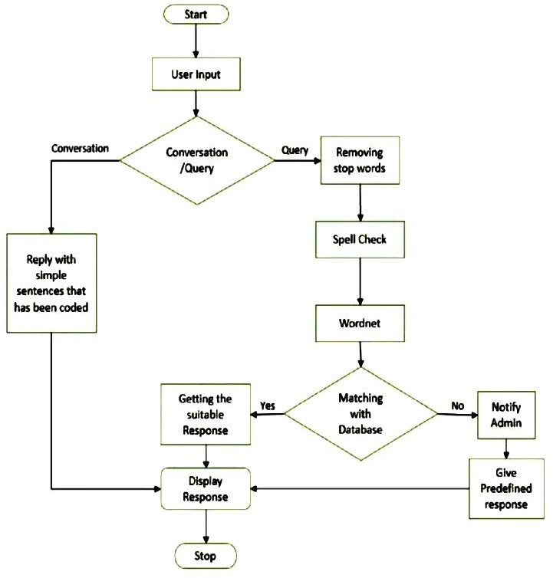
Dept of AI&ML
www.cambridge.edu.in

Slide 10
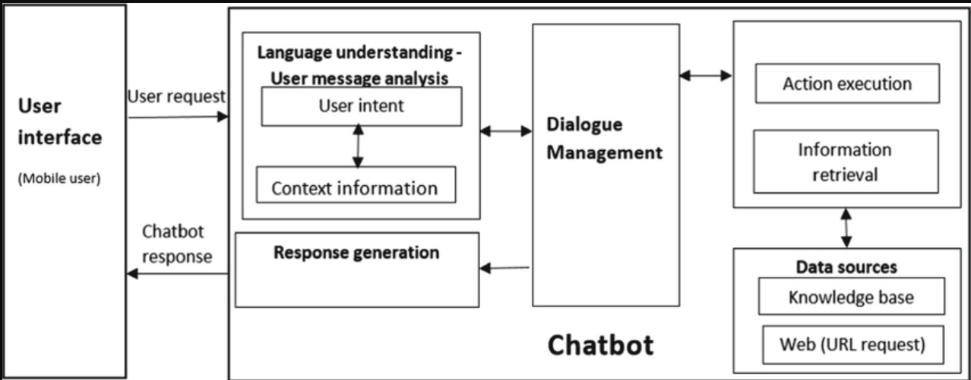
Data Flow Diagram
Dept of AI&ML
www.cambridge.edu.in

Slide 11
IMPLEMENTATION
1. Requirements Definition:
Define project objectives and target audience.
Identify use cases and required functionalities.
2. Technology Stack Selection:
Choose NLP libraries (NLTK, spaCy), ML frameworks (TensorFlow, PyTorch), and chatbot development platforms.
3. Data Collection and Preprocessing:
Gather diverse datasets for training.
Preprocess data through cleaning, tokenization, and labeling.
4. NLP Model Training:
Train the model using selected ML framework.
Implement tokenization, partofspeech tagging, and intent/entity recognition.
Dept of AI&ML
www.cambridge.edu.in

Slide 12
IMPLEMENTATION
5. Integration with External Systems:
Integrate with external systems or databases using APIs.
6. Chatbot Application Development:
Develop the application layer incorporating the trained NLP model.
Implement modules for user input processing and response generation.
7. User Interface Design:
Design an intuitive interface for user interaction.
8. User Data Management:
Implement mechanisms for storing and managing userspecific data.
9. Error Handling and Feedback Mechanisms:
Develop error handling mechanisms and user feedback loops.
10. Security Implementation:
Ensure security measures, including data encryption and user authentication.
Dept of AI&ML
www.cambridge.edu.in

Slide 13
IMPLEMENTATION
11. Testing and Quality Assurance:
Conduct unit testing, integration testing, and user acceptance testing.
12. Deployment:
Deploy the chatbot to the desired platform.
13. Monitoring and Analytics:
Implement monitoring tools for performance tracking and analytics for insights.
14. Continuous Improvement:
Establish mechanisms for feedback loops and periodic model retraining.
15. Documentation and Training:
Provide comprehensive documentation for developers and endusers.
Offer training materials for effective interaction.
16. User Feedback Collection:
Encourage user feedback for iterative improvements and enhanced user satisfaction.
Dept of AI&ML
www.cambridge.edu.in

Slide 14
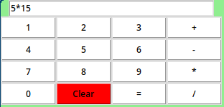
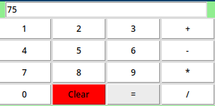
RESULTS
Dept of AI&ML
www.cambridge.edu.in

Slide 15
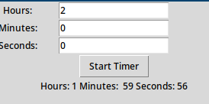
RESULTS
Dept of AI&ML
www.cambridge.edu.in

Slide 16
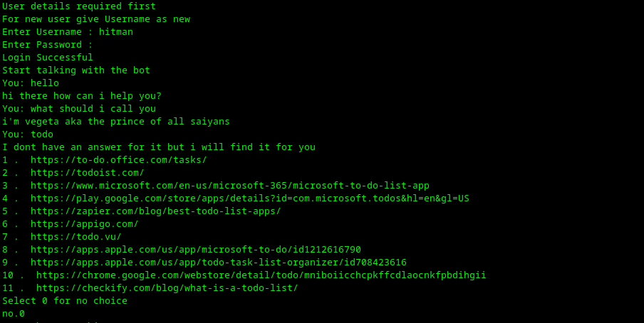
RESULTS
Dept of AI&ML
www.cambridge.edu.in

Slide 17
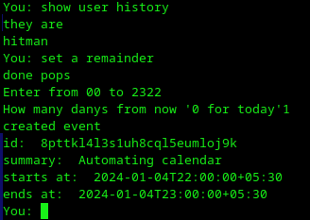
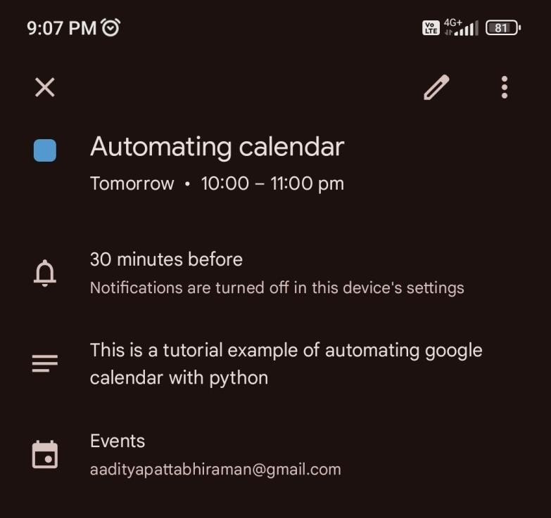
RESULTS
Dept of AI&ML
www.cambridge.edu.in

Slide 18
CONCLUSION AND FUTURE ENHANCEMENTS
User Experience Focus:
Prioritizes user experience by ensuring seamless and engaging interactions.
Security and Scalability:
Emphasizes security and scalability in chatbot development.
Extensive Testing Phases:
Conducts thorough testing, including functional, performance, compatibility, robustness, and security testing.
Continuous Improvement:
Implements continuous improvement mechanisms, including feedback loops and analyticsdriven optimizations.
Technological Advancements:
Commits to staying at the forefront of technological advancements in AI and NLP.
Dept of AI&ML
www.cambridge.edu.in

Slide 19
CONCLUSION AND FUTURE ENHANCEMENTS
Intelligent and Adaptable:
Aims to provide users with an intelligent, adaptable, and secure conversational agent.
Enhanced Interactions:
Envisions enhancing interactions across diverse industries and applications.
Robust Foundation:
The project establishes a robust foundation in NLP technologies for chatbot development.
Dept of AI&ML
www.cambridge.edu.in

Slide 20
THANK YOU
Dept of AI&ML
www.cambridge.edu.in

